Slide 2
The game MathScrabble

Slide 3
Description of the game
It is a Board game that can be played around a table or similar arrangement (even on the floor) on which we place the Board
In the game we can have 2 to 4 players and their goal is to get as many points as possible by placing on the Board tiles that score according to
What symbol they represent, and
Where on the Board they are placed

Slide 4
Background of the game
It is a game very similar to the word game Scrabble, where the object is to construct words using tiles representing letters.
In the MathScrabble case the object is to construct equalities using tiles representing mathematical symbols.
Clearly this analogy is in line with what we call in the Philosophy of Education the Realm of Symbolics. There the natural language and mathematics are constituents and they reflect their meaning as tools for communication.

Slide 5
How do people play scrabble? Example – Video of playing Scrabble

Slide 6
Now for MathSrabble The game can be found in the market under many names and variations, although the basic idea is always the same. Example – Video of playing a variation of MathScrabble

Slide 7
Now in our case: MathScrabble in the context of the MathGames Project

Slide 8
Question 1: What are the basic tools
You can find answers in The Compendium and in the Guidebook of the project
But furthermore we have

Slide 9
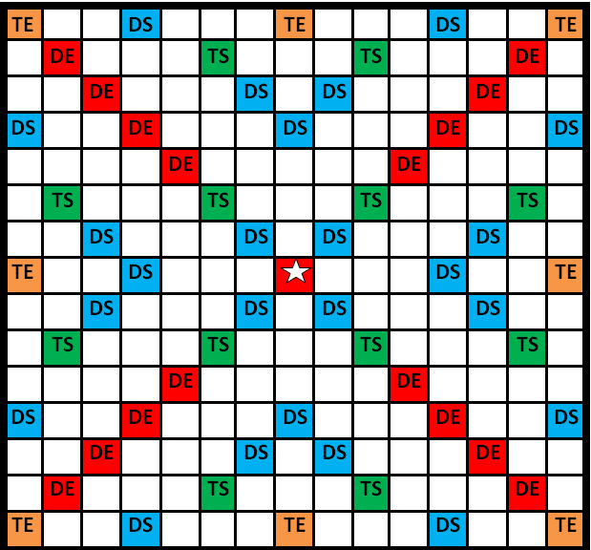
A 15X15 Board with cells where the tiles are going to be placed and where some of these have some special meaning, reflecting in the scoring process.

Slide 10
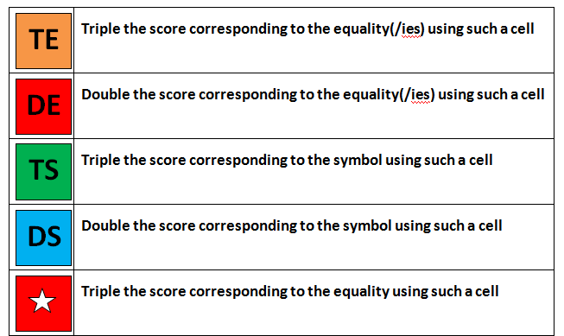

Slide 11
Question 1: What are the basic tools
Tiles in a bag representing
Mathematical digits, or
Mathematical symbols

Slide 15
Question 2:
What are the rules and what is the goal of the game?
How do we play the game?
The answer can be found again in the Compendium and the Guidebook

Slide 20
And now to the crucial question

Slide 21
Question 3: What mathematical concepts/ processes or ideas/ human skills or abilities are involved in the game?
Concepts: The set of the integers, their operations, the concept of equality in the set of integers, coordinates, geometrical figures …
Processes/ skills: the properties of the operations in the set of integers, the properties of equalities, the priority of operations, calculating, problem solving, communication, critical thinking (analysis and comprehension), assessment and evaluation, risk analysis, presentation, strategic thinking, designing, creating or constructing tools….

Slide 22
Question 4: Obviously in the context of the present project we face again the issue:
To what extent does the MathScrabble can help in providing answers to the basic 5 questions we find in the Compendium ?
How can we reduce the number of under skilled adults to promote social integration and participation into our society?
How can we increase incentives for adult training by using games?
How can we offer tailored learning opportunities to individual learners by using games?
How can we provide information on accessing to the services of adult learning?
How can we save traditional and famous games in different countries from being lost?

Slide 23
HOW DO WE DESIGN A LESSON using a game, in this case the mathscrabble, THAT LEADS TO ANSWERING THESE QUESTIONS?
Which really leads to the FOLLOWING basic issue:

Slide 24
Let us review again the Expected Benefits from games in the process of learning mathematics
Creating Interest and Promoting Motivation
Utilizing the Benefits That Games Provide in Engaging Learners in an Environment of Experiential and Active Learning
Socializing the Persons Involved and Exploiting the Competition and Challenge Element
Connecting to Real Life Situations.
Developing a Happy and Joyful Environment.
Utilizing the Design (Structure, Rules, Equipment, Problem Posing etc.) of a Game in Order to Develop an Appropriate Learning Approach

Slide 25
Based on your initial consideration with the game, Can you see any prospect of exploiting any of these prospective benefits in the learning of mathematics process?

Slide 26
In designing a lesson and in view of the goal for achieving the optimum number of benefits of using a game (as referred in the previous slides or more extensively in the Guidebook) I believe that the following aspects are guiding principles:

Slide 27
guiding principle
The Background (cognitive as well as affective) of the learners-students that are going to attend the activities to be included in the playing process.

Slide 28
guiding principle
The General as well as the Special objectives that we set in the context of the game.

Slide 29
guiding principle
The mathematical content that is part of the playing activity.

Slide 30
guiding principle
The approach or methodology that we want to adopt for using these activities (as presented in the Guidebook)
(Is it just an introduction to develop interest?
Is it an opportunity for consolidation?
...)

Slide 31
guiding principle
The Spiral or step by step structure
we are going to adopt
in order to secure gradual involvement of the learners,
both
for understanding the rules of the game as well as
for developing mathematical skills

Slide 32
The lessons presented in the Guidebook are designed (I hope otherwise we failed) in the spirit of these observations

Slide 33
Background of learners
We take it for granted that we have facilitate the learning process in mathematics for slow adult learners with poor mathematical background because of
Poor opportunities during their juvenile ages, or
Special needs, or
Difficulties arising from other reasons (eg language they speak, racial discrimination, etc )

Slide 34
Objectives
The Objectives set (see The Guidebook page 57) cover a broad spectrum. All of these are not expected to be covered in every lesson, but some of them in some of these opportunities

Slide 35
mathematical content
The objectives mentioned in the guidebook as well as the experience we had in reviewing the game provide ample opportunities of including mathematical context, at least at the very elementary level

Slide 36
The approach or methodology Are we going to use the game as
An Introduction to a Mathematical Topic?
An opportunity for Creating a Happy and Joyful Environment?
An Actual Educational Medium for Comprehension of Mathematical Concepts and Processes?
An opportunity for Consolidation of Otherwise Learned Concepts or Processes?
An opportunity for Relating Mathematics to Real Life Situations?
An opportunity for Developing Problem Solving and Critical Thinking Skills?
An opportunity for Boosting Creativity, Productivity and Innovation?
An opportunity for Fixing Relationship Difficulties among the Learners?

Slide 37
The lessons (in the Guidebook pages 61-72) provide the following structure
Getting acquainted with basic mathematical concepts used in MathScrabble
Constructing Equalities using the MathScrabble Symbols
Constructing Equalities and Placing them on the Board Using the Symbols
Constructing Equalities, Placing them on the Board and Calculating the Score Corresponding to them, according to the MathScrabble Rules

Slide 38
Another important aspect that can help the learner to become aware of the basic constituents of the game (guidebook pages 58-60) is the support and guidance for designing and constructing the tools of the game, i.e
Important Remark

Slide 39
Support and Guide the learner for designing and constructing :
The Board (thus learning about geometrical figures and measurement)
The tiles and racks for placing them during the game.
The Cards with the rules of the game (thus having to comprehend what is involved in the game)
The Scoring Sheets (thus realizing the need for calculations).

Slide 40
Workshop Please go over these lessons (as presented in the Guidebook) , study them, review the worksheets, present your comments for discussion and propose possible redesigns of the structure and/ or the worksheets

Slide 41
Let us see another Example of playing another version of the game Video

Slide 42
EXTENSIONS
But certainly it is easy to find out that MathScrabble can be used not only for slow adult learners but also in analogous situations dealing
with children (from the age of 8 and above),
with students at the university level and
with researchers in very advanced fields.

Slide 43
ASSESSMENT- FEEDBACK
What are your comments about the game?
What advantages or disadvantages does the game offers in the process of learning mathematics?
The game is expected to provide the forum for achieving specific and general objectives for Learning mathematics (eg to manipulate integers through recreation, comprehension of concepts and rules and so on) What else could you suggest that can be used for improvement?

